Slide 1
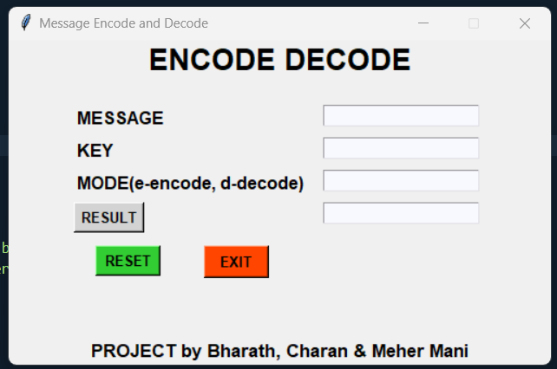
Message Encrypter
II Btech I Sem ANURAG UNIVERSITY
Dept of IT – Cybersecurity
-Python project .
-faculty : Anand Babu sir.

Slide 2
Interface of the encrypter made with tinker

Slide 3
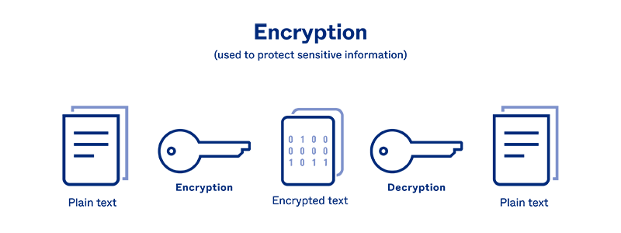
cryptography
This encryption program is based on BASE64 cryptographic algorithm.
Manipulates the given message in binary level.
ASCII codes of given string by translating into radix 64 format.

Slide 4
decryption
The key of the encrypted message plays the major role in decryption, to understand easily we made use of easy keys based on numeric keys.

Slide 5
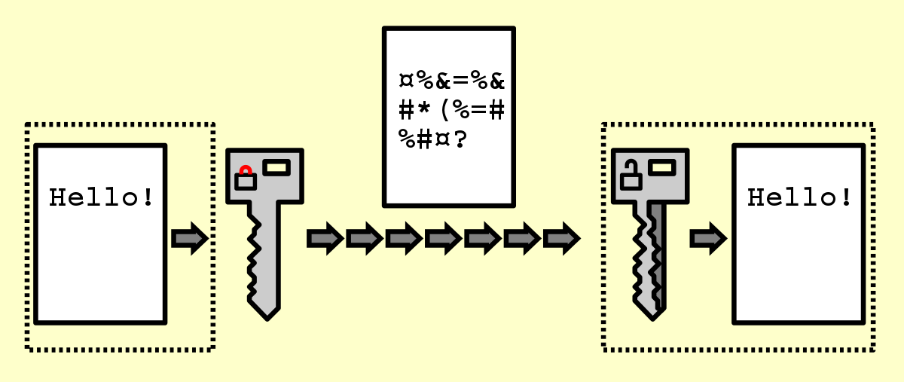
The original message of the user is converted to cipher text.
To obtain the original text the key used while encryption is necessary .

Slide 6
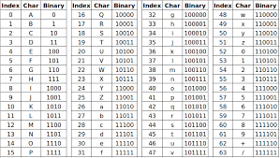
Software requirements
Python latest version to be installed.
Tinker (GUI) package is required.
Crypto package (base64) is required
All OS are supported provided all the above are present and working.

